Slide 1

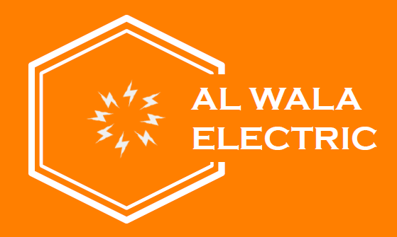

Slide 2
ABOUT US
In 2012 we started providing electrical contracting services in Erbil, today we have presence not just in Erbil but all around the Iraq where we have completed many project. we have grown to take on and deliver many projects.
Thanks to our team’s spirit, work ethos and business ethics we have been able to always satisfy our customers with the work we deliver. AL-WALA ELECTRIC has successfully completed many large scale electrical and automation services to industries such as, hotels, business centres, hospitals and aims to continue to work in these areas.

Slide 3
VISION
* Adhering to the sectors international standards we aim to deliver projects which meet our customer’s satisfaction whilst ensuring we are adding value to the national economy and providing a work place where employees feel valued
MISION
∗ To provide our customers with technical, innovative and commercial solutions whilst complying with International Standards as well as delivering projects efficiently, on time and in a cost effective manner.
AUTOMATION
Equipped with expert engineering staff, AL-WALA ELECTRIC provides the latest in lighting automation, intelligent building systems, process automation and data collection for our customers. We deliver end to end simple and intelligent systems to our customers in a complete package. For each project we have a cost effective, expandable and simple solution which is tailored to specific needs and requirements. Our priority is to ensure that customers can use our automation and data collection propositions to make value added changes, which is driven by our ambition to ensure customers receive the right choice at the best quality.

Slide 4
ENGINEERING
Our company started its operations with a view to become successful, both domestically and internationally, by developing a culture whereby every employee will naturally work towards a healthy and productive methodologies for achieving individual and company goals in the current market conditions. The company was founded in 2012 in Erbil.
Our aim is to make good use of our advancements in the world’s energy, water and underground services to help eliminate energy problems and raise the standard and comfort of living, while always adhering to national and international standards for energy production and distribution. Our experienced team have helped built trust with our customers and investors in the field of electromechanical engineering.
We strive to meet the design and requirements of our customers by closely working with them to find the most suitable solution. We put great emphasis on delivering error free solutions in a timely manner and without compromising on the quality or the service. As a company we always look to incorporate the latest technologies, such as the Internet of Things (IOT) and Artificial Intelligence (AI) however we never deviate from our core value ofdelivering services to meet our customers’ satisfaction and continue to exceed their expectation.
Using the current synergy AL-WALA ELECTRIC will continue to offer the most suitable solutions in the field of electromechanical services. We would like to thank all of the companies we have worked with and our employees for their hard work and hope to continue to work together for the foreseeable future

Slide 5
SERVICES
We provide turnkey projects with system solutions for electrification
of industrial facilities, superstructure and infrastructure projects.
Electrical Systems
• Power Transmission and Distribution
Power Generation
Process and Energy Automation
MV / LV Distribution System
Earthing Systems
Lighting and Lighting Automation Systems
Fire Detection Systems
TV / Audio Systems
Telephone and Data Systems
Security Systems
CCTV Systems
Vehicle and Human Counting Systems
Floor Heating Systems
BMS (Building Management Systems)
Home Automation Systems

Slide 6
SERVICES
Industrial Plants
Waste / Clean Water Treatment Plants
Petroleum and Natural Gas Facilities
Transportation Facilities
Chemical, Food, Pharmaceutical Plants
Mining Facilities
Production Facilities
Integrated Health Facilities
Utility Energy Centers
Co-generation distribution networks
Water, ground or air source heat pump systems
Solar and Wind Power Plants
HEPP (Hydroelectric Power Plant)
Transformer Substations

Slide 7
REFERENCES
EMPIRE WEST WINGS (W1-W11)
EMPIRE BUSINESS TOWERS
SORAN HOSPITAL
MUSUL HOSPITAL
PIRMAM HOSPITAL
FUTURE CITY
BORUM WATER TREATMENT
BEYLIKDUZU METROBUS LINE
KARABUK WATER TREATMENT
SANLIURFA WATER TREATMENT
KKKTC – TRNC BUILDINGS
ISTANBUL CITY CENTER
CONSTANTINE HOTEL- ALGERIA
YENIKAPI WASTE WATER PLANT
DJANET HOTEL- ALGERIA
ORAN MOSQUE – ALGERIA
SUN TOWERS
SHAQLAWA PDK BUILDING
NOVA TOWERS
EMPIRE- PEARL
MASIF VILLA
ERBIL FARM
GMC ERBIL
GULAN MALL- TERANOVA
GULAN MALL - CALIOPE
GULAN MALL- PARFOIS
SLAVA CAR SHOWROOM
PALM BAGHDAD
SKY VIEW TOWERS
AIRPORT VIEW TOWERS
CENTRAL PARK ERBIL

Slide 8
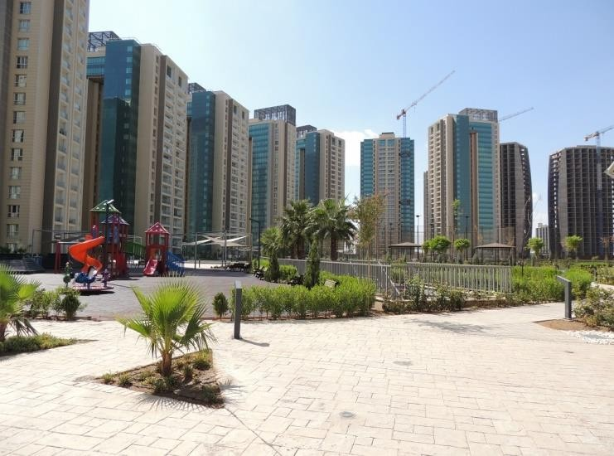
EMPIRE WEST WINGS
PROJECT INFO
EPC: BC GROUP
EXECUTION: 2012- 2020
∗
PROJECT SCOPE
11 BUILDING (944 AP.)
BUSBAR SYSTEM
TRANSFORMERS
MV SWITCHGEARS
LV ELECTRICAL BOARDS AND
EQUIPMENTS (GE)
MANPOWER, INSTALLATION AND COMMISSIONING
CCTV SYSTEM
FIRE ALARM SYSTEM
SMART HOME SYSTEM
TV SYSTEM

Slide 9
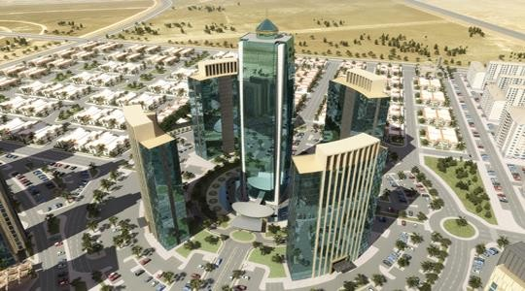
EMPIRE BUSSINESS TOWERS
PROJECT INFO
EPC: PB GROUP
EXECUTION: 2012- 2025
∗
PROJECT SCOPE
4 BUILDING (532 OFFICCE)
BUSBAR SYSTEM
TRANSFORMERS
MV SWITCHGEARS
LV ELECTRICAL BOARDS AND
EQUIPMENTS (GE)
MANPOWER, INSTALLATION AND COMMISSIONING
CCTV SYSTEM
FIRE ALARM SYSTEM

Slide 10
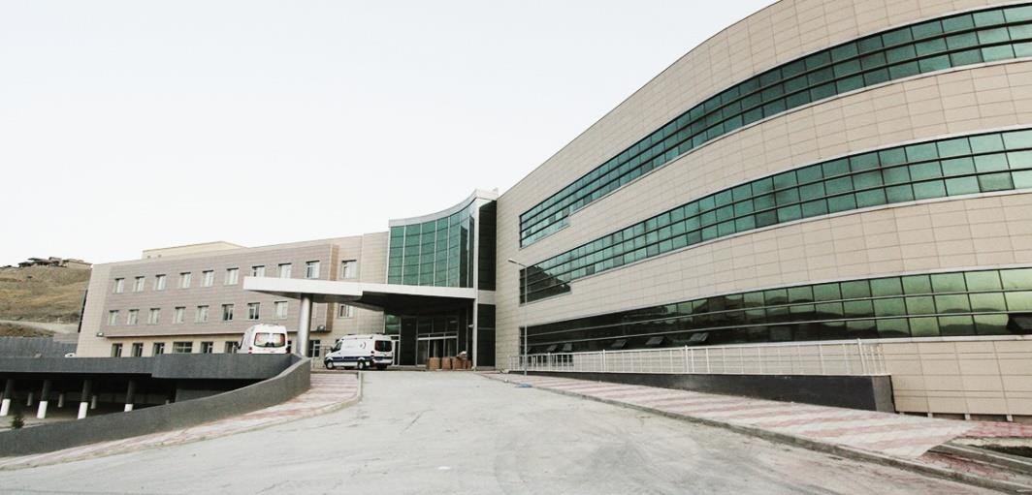
SORAN HOSPITAL
PROJECT INFO
EPC: BC GROUP
EXECUTION: 2010-2012
∗
PROJECT SCOPE
MV SWITCHGEARS
TRANSFORMERS
ELECTRICAL INFRASTRUCTURE
MANPOWER, INSTALLATION AND COMMISSIONING
FIRE ALARM, CCTV, TV, NURSE
CALL SYSTEMS

Slide 11
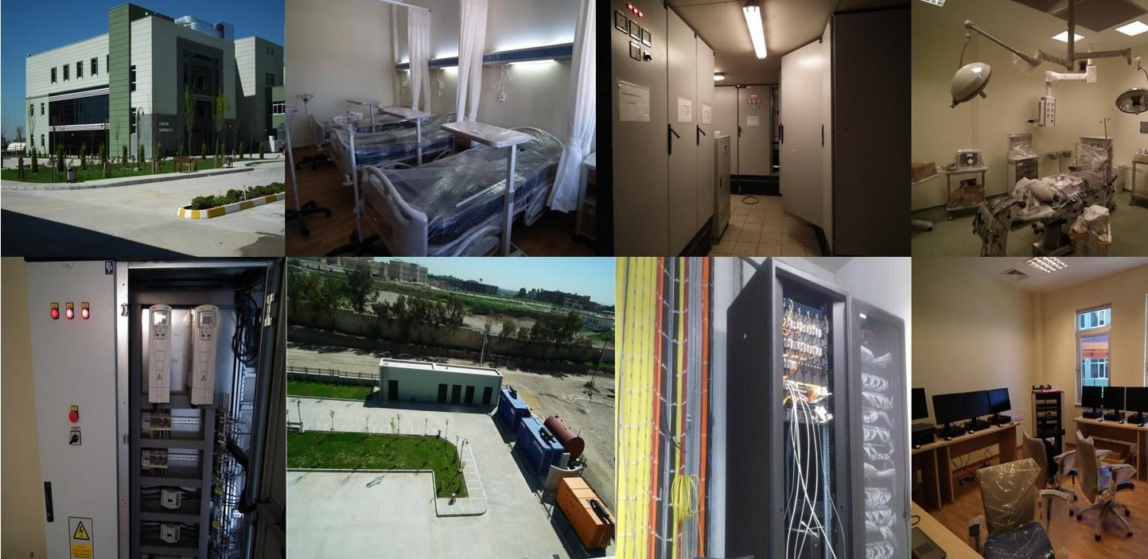
MUSUL HOSPITAL
PROJECT INFO
EPC: TEK-IMAS CO.
EXECUTION: 2010-2012
∗
PROJECT SCOPE
MV SWITCHGEARS
TRANSFORMERS
ELECTRICAL INFRASTRUCTURE
MANPOWER, INSTALLATION AND COMMISSIONING
FIRE ALARM, CCTV, TV, NURSE
CALL SYSTEMS

Slide 12
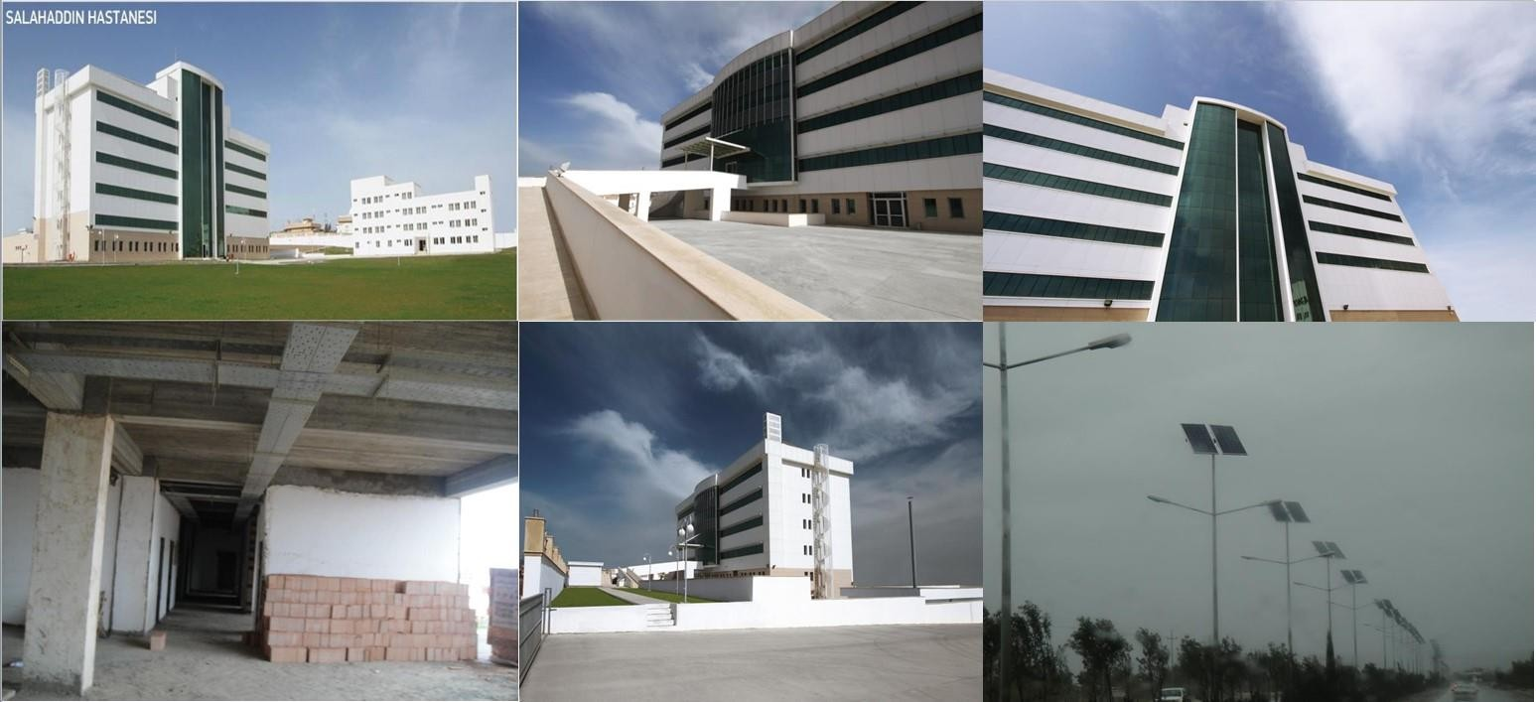
PIRMAM HOSPITAL
PROJECT INFO
EPC: BC GROUP
EXECUTION: 2010-2012
∗
PROJECT SCOPE
MV SWITCHGEARS
TRANSFORMERS
ELECTRICAL INFRASTRUCTURE
MANPOWER, INSTALLATION AND COMMISSIONING
FIRE ALARM, CCTV, TV,
NURSE CALL SYSTEMS

Slide 13
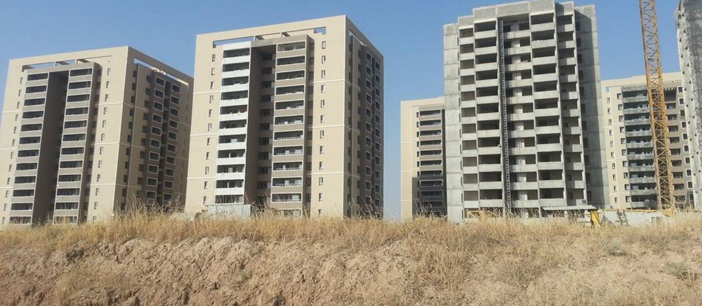
FUTURE CITY
PROJECT INFO
EPC: DAGLI GROUP
EXECUTION: 2011-2014
PROJECT SCOPE
MV SWITCHGEARS
TRANSFORMERS
LV ELECTRICAL BOARDS & EQUIPMENTS (GE)
ELECTRICAL INFRASTRUCTURE
MANPOWER, INSTALLATION AND COMMISSIONING
FIRE ALARM SYSTEM

Slide 14
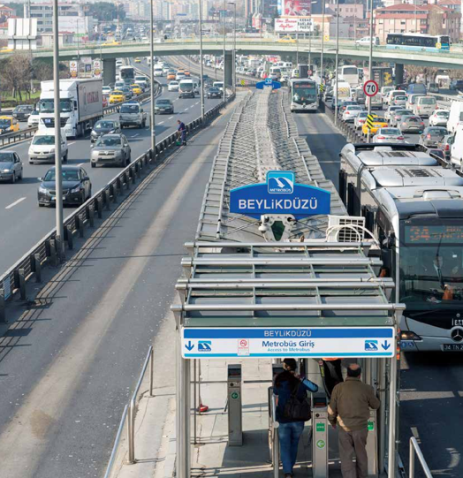
BEYLIKDUZU METROBUS LINE
PROJECT INFO
EPC: NAS & OZYURT CONSTRUCTION
EXECUTION: 2011- 2012
PROJECT SCOPE
MV SWITCHGEARS
TRANSFORMERS
LV ELECTRICAL BOARDS & EQUIPMENTS (GE)
ELECTRICAL INFRASTRUCTURE

Slide 15
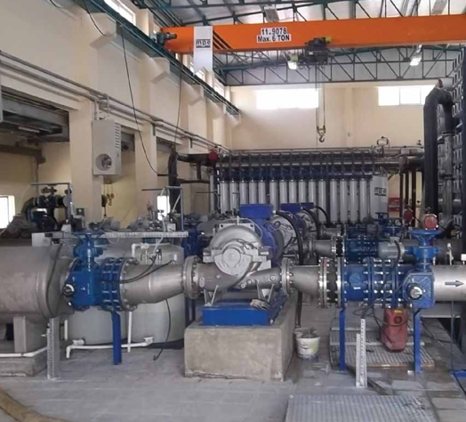
KARABUK WATER TREATMENT
PROJECT INFO
EPC: MPE ENGINEERING
EXECUTION: 2011- 2012
PROJECT SCOPE
MV SWITCHGEARS
TRANSFORMERS
LV ELECTRICAL BOARDS & EQUIPMENTS
ELECTRICAL INFRASTRUCTURE

Slide 16
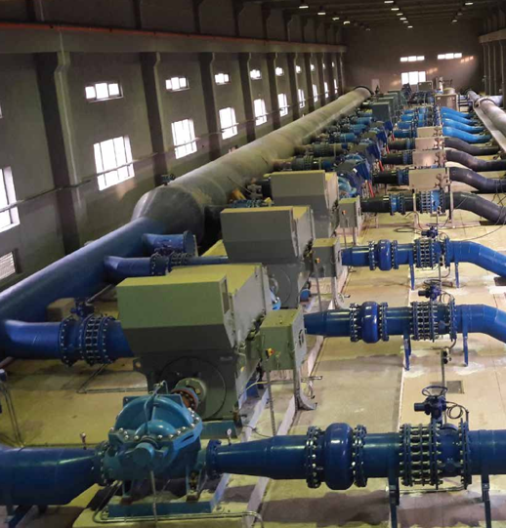
SANLIURFA WATER TREATMENT
PROJECT INFO
EPC: DSI & BINAS CONSTRUCTION
EXECUTION: 2012- 2014
PROJECT SCOPE
ELECTRICAL & MECHANICAL AUTOMATION SYSTEMS

Slide 17
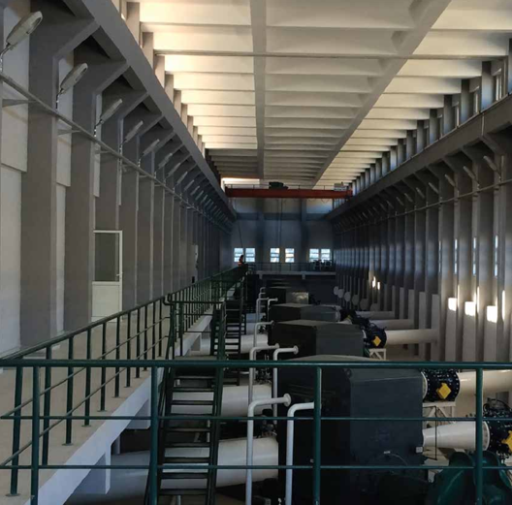
KKTC – TRNC BUILDINGS
PROJECT INFO
EPC: KAYI HOLDING
EXECUTION: 2012- 2014
PROJECT SCOPE
ELECTRICAL WORKS
AUTOMATION SYSTEMS

Slide 18
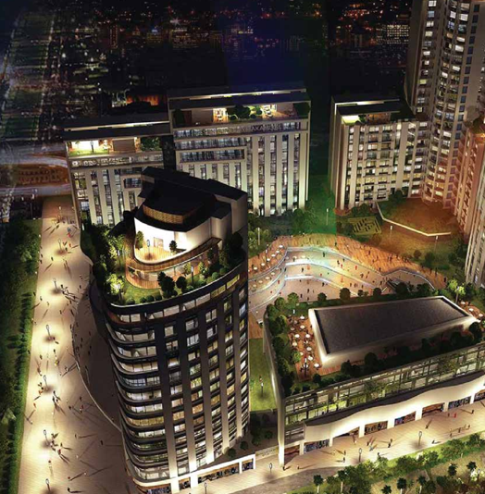
ISTANBUL CITY CENTER
PROJECT INFO
EPC: OZYURT CONSTRUCTION
EXECUTION: 2014- 2019
PROJECT SCOPE
BUSBAR SYSTEM
TRANSFORMERS
MV SWITCHGEARS
LV ELECTRICAL BOARDS AND
EQUIPMENTS (GE)
MANPOWER, INSTALLATION AND COMMISSIONING
CCTV SYSTEM
FIRE ALARM SYSTEM
SMART HOME SYSTEM
TV SYSTEM

Slide 19
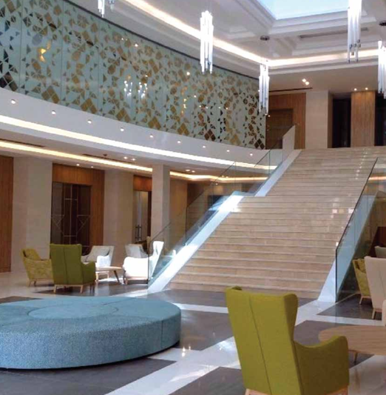
CONSTANTINE HOTEL ALGERIA
PROJECT INFO
EPC: KAYI HOLDING
EXECUTION: 2014- 2016
PROJECT SCOPE
BUSBAR SYSTEM
TRANSFORMERS
MV SWITCHGEARS
LV ELECTRICAL BOARDS AND
EQUIPMENTS
MANPOWER, INSTALLATION AND COMMISSIONING
CCTV SYSTEM
FIRE ALARM SYSTEM
TV SYSTEM
KNX SMART SYSTEM

Slide 20
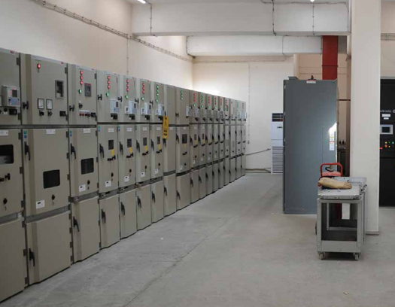
YENIKAPI WASTEWATER PLANT
PROJECT INFO
EPC: DSI
EXECUTION: 2015- 2016
PROJECT SCOPE
MV SWITCHGEARS
TRANSFORMERS
LV ELECTRICAL BOARDS & EQUIPMENTS
ELECTRICAL INFRASTRUCTURE

Slide 21
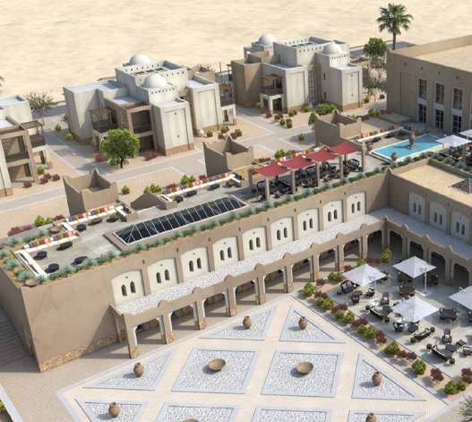
DJANET HOTEL ALGERIA
PROJECT INFO
EPC: KAYI HOLDING
EXECUTION: 2016- 2020
PROJECT SCOPE
MV SWITCHGEARS
LV ELECTRICAL BOARDS AND
EQUIPMENTS
MANPOWER, INSTALLATION AND COMMISSIONING
CCTV SYSTEM
FIRE ALARM SYSTEM

Slide 22
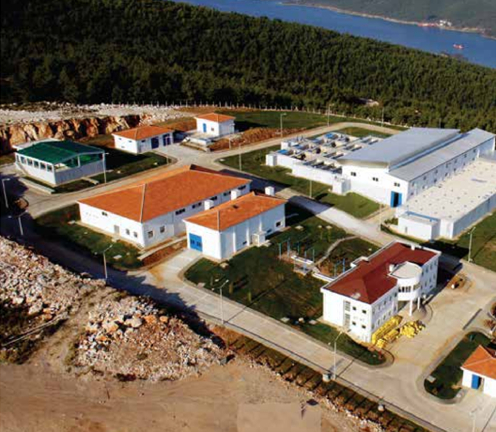
BODRUM WATER TREATMENT
PROJECT INFO
EPC: DSI & BINAS CONSTRUCTION
EXECUTION: 2010- 2011
PROJECT SCOPE
ELECTRICAL SYSTEMS

Slide 23
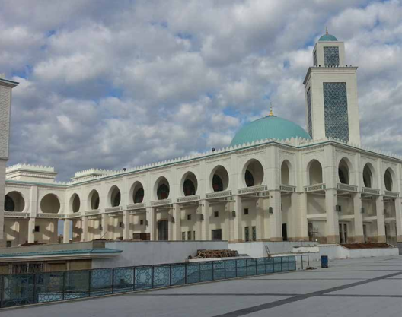
ORAN MOSQUE ALGERIA
PROJECT INFO
EPC: KAYI HOLDING
EXECUTION: 2014- 2015
PROJECT SCOPE
ELECTRICAL WORKS

Slide 24
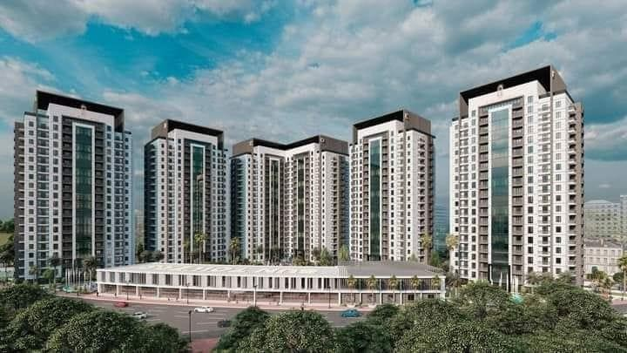
SUN TOWERS
PROJECT INFO
EPC: LALAV GROUP
EXECUTION: 2021- CONTINUES
PROJECT SCOPE
MV SWITCHGEARS
TRANSFORMERS
LV ELECTRICAL BOARDS & EQUIPMENTS
BUSDUCT SYSTEMS
ELECTRICAL INFRASTRUCTURE
MANPOWER, INSTALLATION AND COMMISSIONING

Slide 25
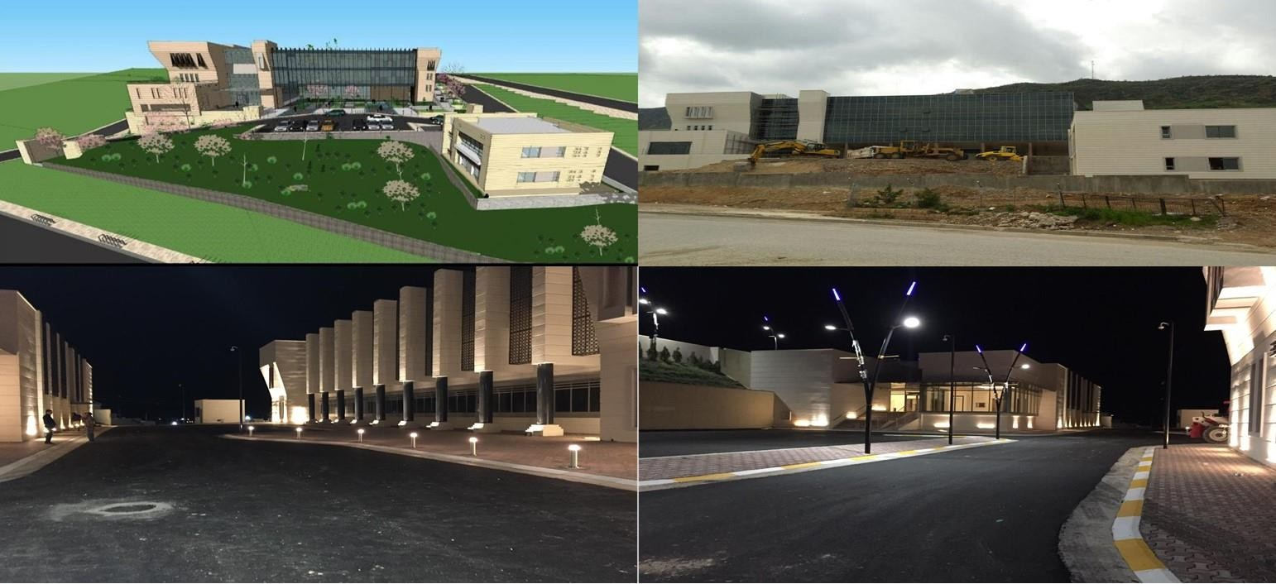
SHAQLAWA PDK BUILDING
PROJECT INFO
EPC: TEK-IMAS CO
EXECUTION: 2013-2015
PROJECT SCOPE
MV SWITCHGEARS
TRANSFORMERS
LV ELECTRICAL BOARDS & EQUIPMENTS (GE)
ELECTRICAL INFRASTRUCTURE
MANPOWER, INSTALLATION AND COMMISSIONING
FIRE ALARM, CCTV, TV, PHONE, ANNOUNCE SYSTEMS
DATA CENTER

Slide 26
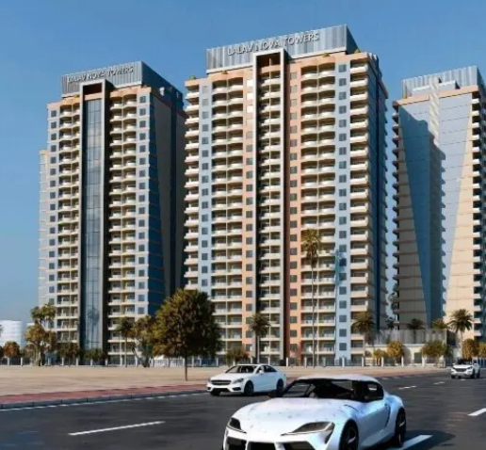
NOVA TOWERS
PROJECT INFO
EPC: LALAV GROUP
EXECUTION: 2022- ON GOING
PROJECT SCOPE
LV ELECTRICAL BOARDS & EQUIPMENTS
ELECTRICAL INFRASTRUCTURE
MANPOWER, INSTALLATION AND COMMISSIONING
BUSDUCK TRACKING SYSTEM

Slide 27
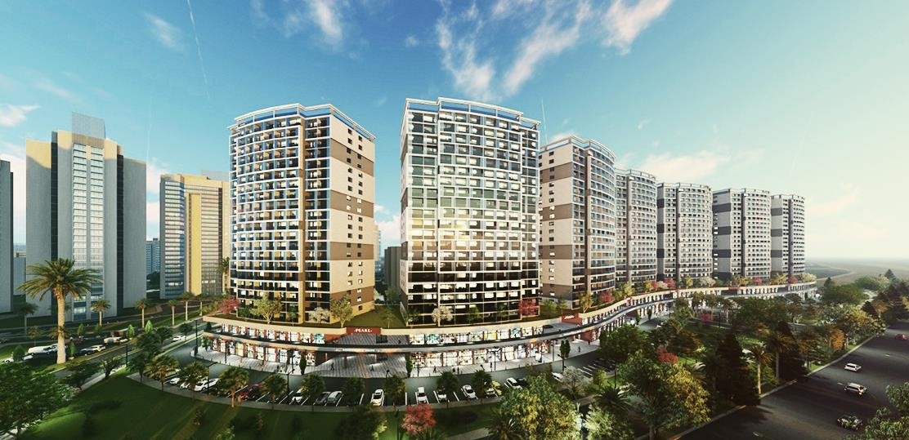
EMPIRE PEARL TOWERS
PROJECT INFO
EPC: BC GROUP
EXECUTION: 2021-
CONTINUES
PROJECT SCOPE
BUSDUCK TRACKING SYSTEM INSTALLATION
JET-FAN AUTOMATION SYSTEM
CO ALARM SYSTEM
FIRE ALARM SYSTEM,

Slide 28
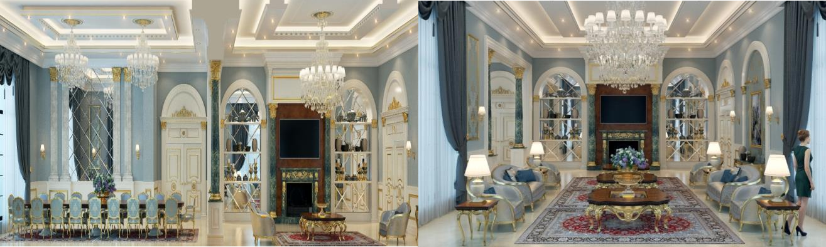
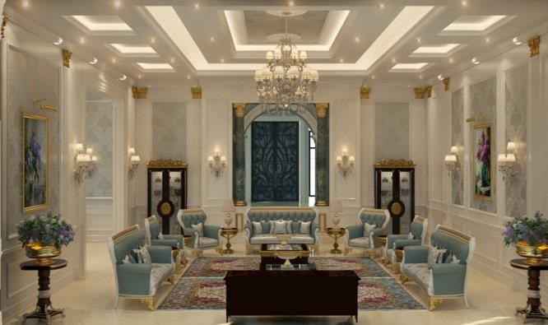
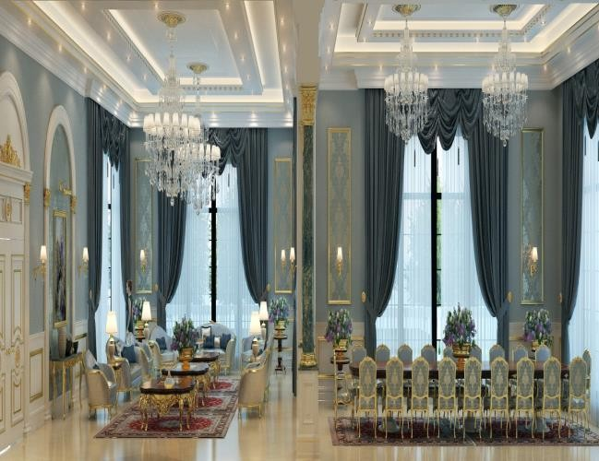
MASIF VILLA
PROJECT INFO
EPC: BC GROUP
EXECUTION: 2018-2020
PROJECT SCOPE
LV ELECTRICAL BOARDS & EQUIPMENTS (GE)
ELECTRICAL INFRASTRUCTURE
MANPOWER, INSTALLATION AND COMMISSIONING
CCTV, TV, INTERCOM
SYSTEM
SMARTHOME
DALI SYSTEM

Slide 29
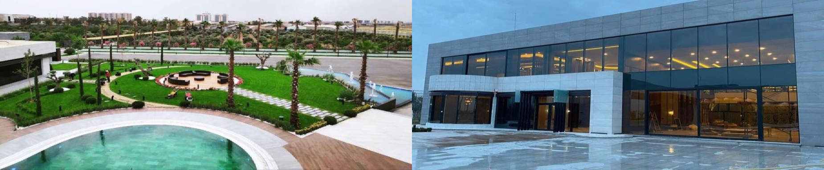
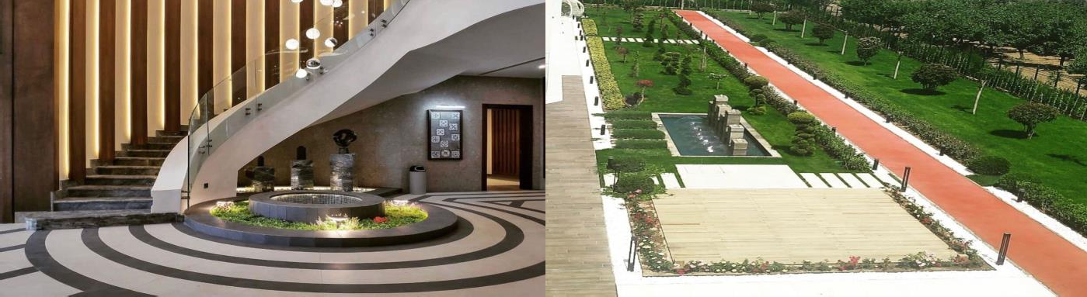
ERBIL FARM
PROJECT INFO
EPC: BC GROUP
EXECUTION: 2018-
2020
PROJECT SCOPE
LV ELECTRICAL BOARDS & EQUIPMENTS
ELECTRICAL INFRASTRUCTURE
MANPOWER, INSTALLATION AND COMMISSIONING

Slide 30
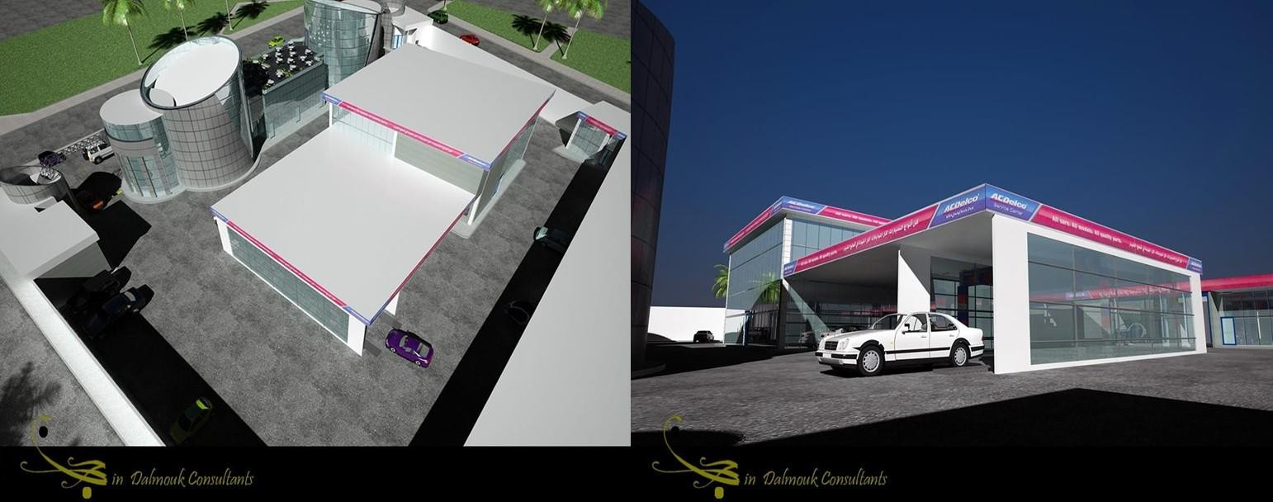
GMC ERBIL
PROJECT INFO
EPC: BC GROUP
EXECUTION: 2018-
2020
PROJECT SCOPE
LV ELECTRICAL BOARDS & EQUIPMENTS
ELECTRICAL INFRASTRUCTURE
MANPOWER, INSTALLATION AND COMMISSIONING

Slide 31
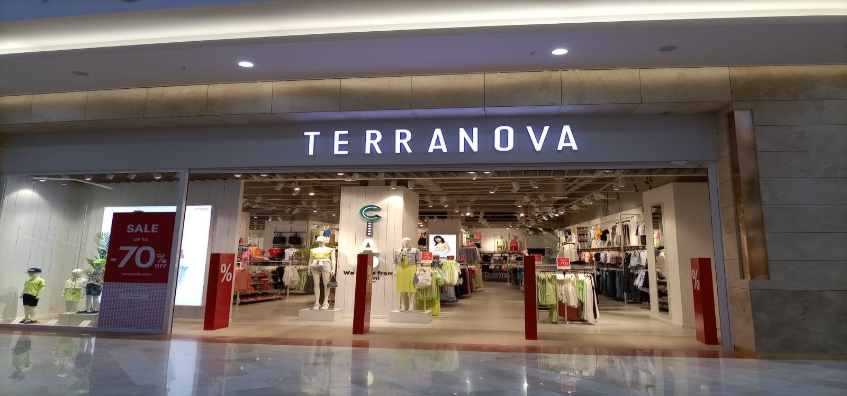
GULAN MALL TERANOVA
PROJECT INFO
EPC: BTK CO.
EXECUTION: 2022-2022
PROJECT SCOPE
LV ELECTRICAL BOARDS & EQUIPMENTS
ELECTRICAL INFRASTRUCTURE
MANPOWER, INSTALLATION AND COMMISSIONING
FIRE ALARM SYSTEM,
CCTV, SOUND SYSTEMS

Slide 32
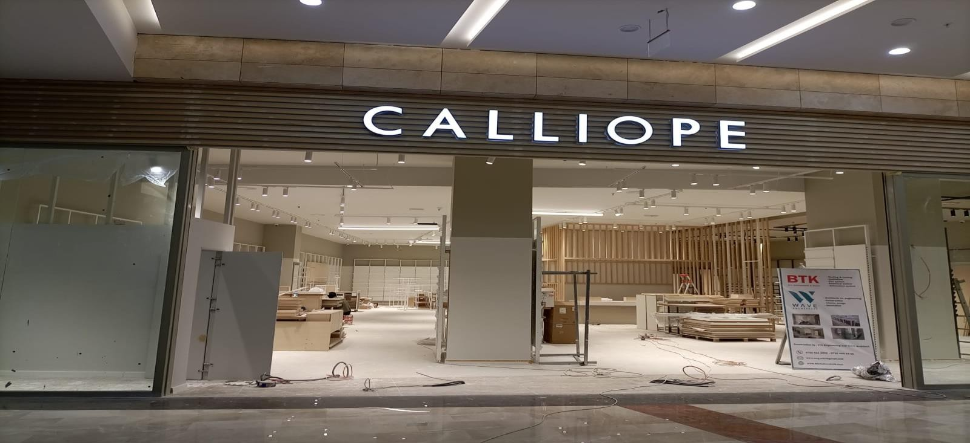
GULAN MALL CALIOPE
PROJECT INFO
EPC: BTK CO.
EXECUTION: 2022-2022
PROJECT SCOPE
LV ELECTRICAL BOARDS & EQUIPMENTS
ELECTRICAL INFRASTRUCTURE
MANPOWER, INSTALLATION AND COMMISSIONING
FIRE ALARM SYSTEM,
CCTV, SOUND SYSTEMS

Slide 33
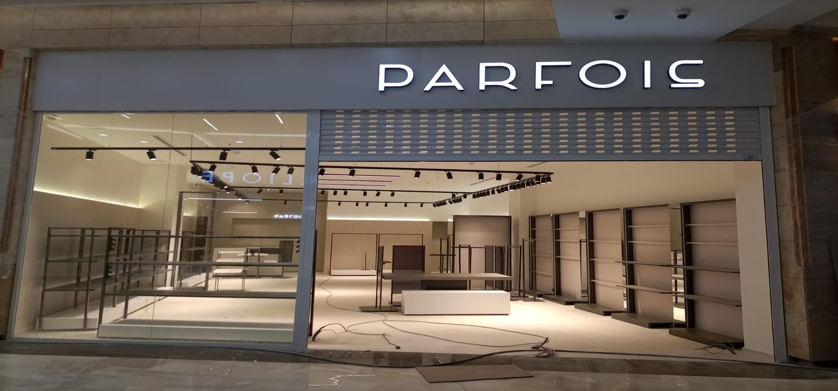
GULAN MALL PARFIOS
PROJECT INFO
EPC: BTK CO.
EXECUTION: 2022-2022
PROJECT SCOPE
LV ELECTRICAL BOARDS & EQUIPMENTS
ELECTRICAL INFRASTRUCTURE
MANPOWER, INSTALLATION AND COMMISSIONING
FIRE ALARM SYSTEM,
CCTV, SOUND SYSTEMS

Slide 34
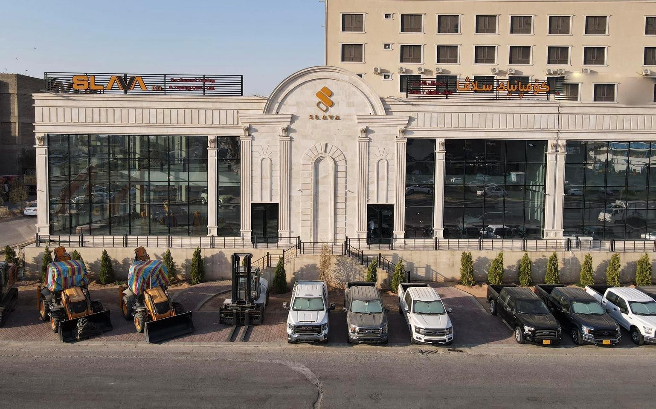
SLAVA CAR SHOWROOM
PROJECT INFO
EPC: SLAVA GROUP
EXECUTION: 2022-2022
PROJECT SCOPE
LV ELECTRICAL BOARDS & EQUIPMENTS
ELECTRICAL INFRASTRUCTURE
MANPOWER, INSTALLATION AND COMMISSIONING
FIRE ALARM SYSTEM, CCTV,
SOUND SYSTEMS

Slide 35
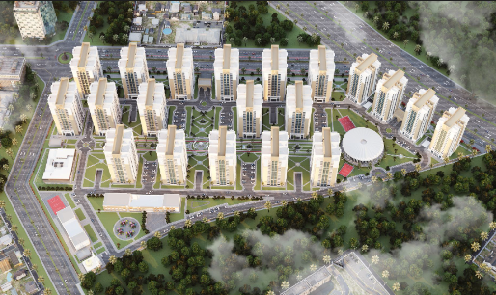
PALM BAGHDAD
PROJECT INFO
EPC: BC GROUP
EXECUTION: 2022-2022
PROJECT SCOPE
LV ELECTRICAL BOARDS & EQUIPMENTS
ELECTRICAL INFRASTRUCTURE
MANPOWER, INSTALLATION AND COMMISSIONING

Slide 36
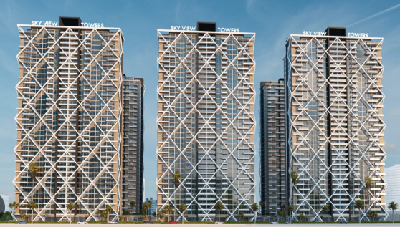
SKY VIEW TOWERS
PROJECT INFO
EPC: LALAV GROUP
EXECUTION: 2022- CONTINUES
PROJECT SCOPE
LV ELECTRICAL BOARDS & EQUIPMENTS
ELECTRICAL INFRASTRUCTURE
BUSDUCT SYSTEMS
MANPOWER, INSTALLATION AND COMMISSIONING

Slide 37
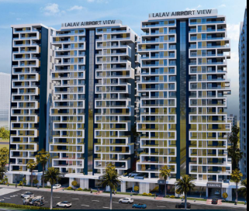
LALAV AIRPORT VIEW
PROJECT INFO
EPC: LALAV GROUP
EXECUTION: 2020- CONTINUES
PROJECT SCOPE
LV ELECTRICAL BOARDS & EQUIPMENTS

Slide 38
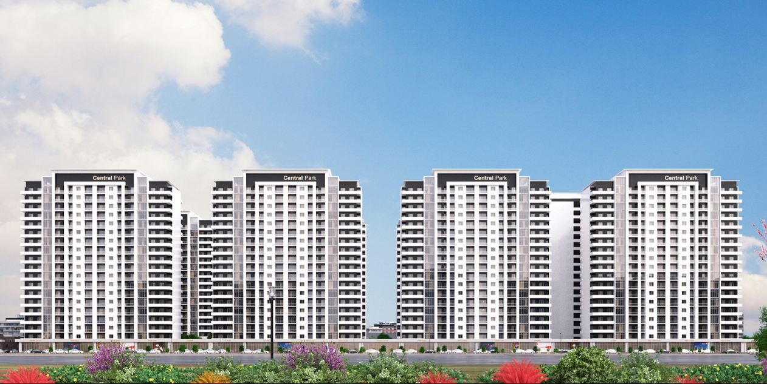
CENTRAL PARK
PROJECT INFO
EPC: BARBYAN CO
EXECUTION: 2024- CONTINUES
PROJECT SCOPE
LV ELECTRICAL BOARDS & EQUIPMENTS
BUSDUCK SYSTEMS

Slide 39


















OUR SOLUTION PARTNER

Slide 40

Empire Pearl Towers P6 Floor 1
No: B/101 Erbil – Iraq
+964 750 310 69 84
www.alwalaelectric.com

